Slide 1
Decision Tree

Slide 2
Classification
Databases are rich with hidden information that can be used for making intelligent decisions.
Classification is a form of data analysis that can be used to extract models describing important data classes.

Slide 3
Data classification process
Learning
  Training data are analyzed by a classification algorithm.
Classification
  Test data are used to estimate the accuracy of the classification rules.
  If the accuracy is considered acceptable, the rules can be applied to the classification of new data tuples.

Slide 4
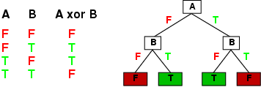
Expressiveness
Decision trees can express any function of the input attributes.
E.g., for Boolean functions, truth table row → path to leaf:
Trivially, there is a consistent decision tree for any training set with one path to leaf for each example (unless f nondeterministic in x) but it probably won't generalize to new examples
Prefer to find more compact decision trees

Slide 5
What’s a decision tree
A decision tree is a flow-chart-like tree structure, where each internal node denotes a test on an attribute, each branch represents an outcome of the test, and leaf nodes represent classes or class distributions.
Decision trees can easily be converted to classification rules.

Slide 6
Example
Training data
Name | Age | Income | Credit_rating
Snady | <=30 | Low | Fair
Bill | <=30 | Low | Excellent
Courney | 31..40 | High | Excellent
Susan | >40 | Med | Fair
Claire | >40 | Med | Fair
Andre | 31..40 | High | Excellent
……
Classification
algorithm
Classification rules
If age =“31..40” and income=high Then Credit_rating=excellent
Classification
rules
New data
(John, 31..40, high) Credit rating?
Test data
Name | Age | Income | Credit_rating
Snady | <=30 | Low | Fair
Bill | <=30 | Low | Excellent
Courney | 31..40 | High | Excellent
……
Excellent

Slide 7
Example
RID | Age | Income | Student | Credit_rating | Class: buys_computer
1 | <=30 | High | No | Fair | No
2 | <=30 | High | No | Excellent | No
3 | 31..40 | High | No | Fair | Yes
4 | >40 | Medium | No | Fair | Yes
5 | >40 | Low | Yes | Fair | Yes
6 | >40 | Low | Yes | Excellent | No
7 | 31..40 | Low | Yes | Excellent | Yes
8 | <=30 | Medium | No | Fair | No
9 | <=30 | Low | Yes | Fair | Yes
10 | >40 | Medium | Yes | Fair | Yes
11 | <=30 | Medium | Yes | Excellent | Yes
12 | 31..40 | Medium | No | Excellent | Yes
13 | 31..40 | High | Yes | Fair | Yes
14 | >40 | Medium | No | Excellent | No

Slide 8
Example
Age?
<=30
>40
Student?
31..40
Credit_rating?
Yes
no
yes
excellent
fair
No
Yes
No
Yes
Buys computer

Slide 9
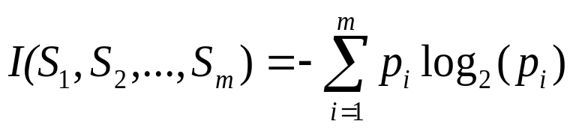
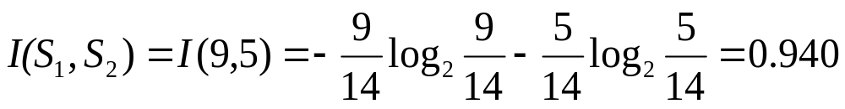
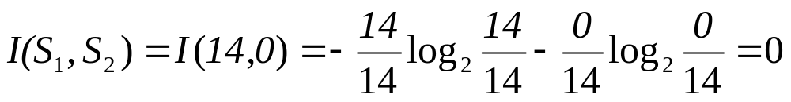
Decision tree induction (ID3)
Attribute selection measure
  The attribute with the highest information gain (or greatest entropy reduction) is chosen as the test attribute for the current node
  The expected information needed to classify a given sample is given by

Slide 10
Example (cont.)
RID | Age | Income | Student | Credit_rating | Class: buys_computer
1 | <=30 | High | No | Fair | No
2 | <=30 | High | No | Excellent | No
3 | 31..40 | High | No | Fair | Yes
4 | >40 | Medium | No | Fair | Yes
5 | >40 | Low | Yes | Fair | Yes
6 | >40 | Low | Yes | Excellent | No
7 | 31..40 | Low | Yes | Excellent | Yes
8 | <=30 | Medium | No | Fair | No
9 | <=30 | Low | Yes | Fair | Yes
10 | >40 | Medium | Yes | Fair | Yes
11 | <=30 | Medium | Yes | Excellent | Yes
12 | 31..40 | Medium | No | Excellent | Yes
13 | 31..40 | High | Yes | Fair | Yes
14 | >40 | Medium | No | Excellent | No

Slide 11
Example (cont.)
Compute the entropy of each attribute, e.g., age
  For age=“<=30”: s₁₁=2, S₂₁=3, I(s₁₁,s₂₁)=0.971
  For age=“31..40”: s₁₂=4, s₂₂=0, I(s₁₂,s₂₂)=0
  For age=“>40”: s₁₃=3, s₂₃=2, I(s₁₃,s₂₃)=0.971
31..40
<=30
>40

Slide 12
Example (cont.)
The entropy according to age is
E(age)=5/14*I(s₁₁,s₂₁)+4/14*I(s₁₂,s₂₂)+5/14*I(s₁₃,s₂₃)
=0.694
The information gain would be
Gain(age)=I(s₁,s₂)-E(age)=0.246
Similarly, we can compute
  Gain(income)=0.029
  Gain(student)=0.151
  Gain(credit_rating)=0.048

Slide 13
Example (cont.)
Age?
<=30
>40
Income | Student | Credit_rating | class
High | No | Fair | No
High | No | Excellent | No
Medium | No | Fair | No
Low | Yes | Fair | Yes
Medium | Yes | Excellent | Yes
Income | Student | Credit_rating | class
Medium | No | Fair | Yes
Low | Yes | Fair | Yes
Low | Yes | Excellent | No
Medium | Yes | Fair | Yes
Medium | No | Excellent | No
31..40
Income | Student | Credit_rating | class
High | No | Fair | Yes
Low | Yes | Excellent | Yes
Medium | No | Excellent | Yes
High | Yes | Fair | Yes

Slide 14
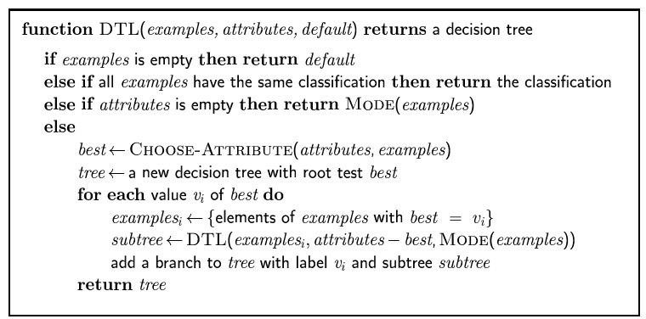
Decision tree learning
Aim: find a small tree consistent with the training examples
Idea: (recursively) choose "most significant" attribute as root of (sub)tree

